Slide 1
How to use this deck
Questions? Feedback? Contact: Amit Kara and Ryan Decosmo
Use Corporate Pitch Deck for introducing Databricks Data Intelligence Platform
Understand key platform capabilities that are dependent on UC and unlocked only with UC
Use the Unity Catalog Sales Pitch to introduce customers to Unity Catalog
Use this Unity Catalog Technical Pitch to explain the inner workings of Unity Catalog
Visit go/uc for more technical resources

Slide 2
Unity Catalog
Unified and open governance for data and AI
Speaker Name / Title

Slide 3



Governance is critical to scale your data and AI initiatives
“Organizations are finally realizing the value of data as an asset that needs to be protected, managed and maintained to increase asset value”
“Organizations seeing the highest returns from AI have a framework for AI governance to cover every step of the model development process”
“AI is now an enterprise essential, and as such, AI governance will join cybersecurity and compliance as a board-level topic”
Notes:
Governance for data and AI is critical to scaling your data and AI initiatives
In the age of generative AI and LLMs, the governance of data and AI has become paramount, given the growth and utilization of data, ML models
The foundational principles of governance - accountability, compliance, quality, and transparency - traditionally essential for data management, now extend equally to AI.
For example, Forrester predicts AI governance is now going to be board-level topic
[Click]

Slide 4




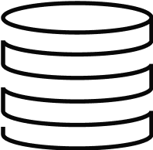
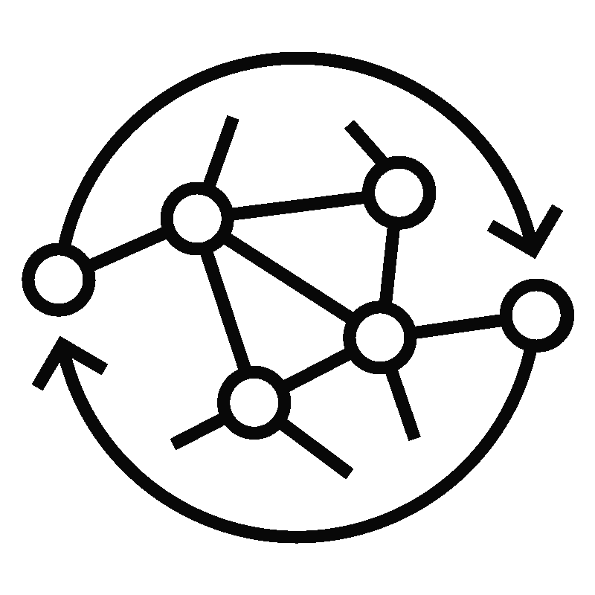



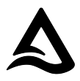


But governance of the entire data estate is hard
Multiple data Sources
Diverse data and AI assets
Data lake
Tables
Databases
Files
Data warehouse
AI Models
Fragmented governance for data and AI
Across access management, auditing, monitoring, observability, and lineage
Silos
Notebooks
Catalogs
Lack of open connectivity
For access and cross-platform collaboration
Dashboards
Lack of built-in intelligence
For data discovery, understanding, and gaining domain insights
Delta Lake
Parquet
Iceberg
Heterogeneous data formats
Notes:
Though everyone understands its importance, governance of the entire data estate is hard, let's see how
In most organizations, data is spread across databases, data warehouses, data lakes, and even other catalogs.
You also have fragmentation across data formats such as Delta Lake, and Iceberg. Many solutions or platforms out in the market work with one or another which causes fragmentation of the ecosystem and you have to choose one over the other.
Finally, you not just have structured data in tables but also unstructured data in files as well as other assets like ML models, notebooks, and dashboards that need to be managed and governed.
This creates silos across sources, formats and assets
[Click]
And This causes challenges from a governance standpoint
You suffer from fragmented governance for data and AI, which makes it hard to manage access policies, auditing, monitoring, observability, and lineage across these silos
There is a Lack of open connectivity which makes it hard for consumers to access and share data and AI across tools, engines and platforms and collaborate for broad interoperability
Finally, there is a lack of built-in intelligence for consumers to easily discover, and understand these diverse data and AI assets across silos and get domain knowledge specific to organizations which leads to a heavy reliance on technical experts. Without this intelligence, platforms fall short of connecting business concepts with underlying data and models, creating a bottleneck where experts are needed
[Click]

Slide 5

These challenges impact business value
Compliance, security and quality risks
Operational inefficiencies
Fragmented governance
Vendor lock-in
Higher operational cost
Lack of open connectivity
Slow speed of innovation
Missed competitive edge
Lack of built-in intelligence
Notes:
And these governance challenges have consequences on the business value.
Fragmented governance leads to increased compliance, security, and quality risks, as well as operational inefficiency, as businesses struggle to maintain a unified view of their data and AI ecosystems.
Lack of open connectivity leads to vendor lock-in and limits an organization’s ability to switch vendors or integrate new technologies as needs evolve. Poor interoperability further hinders collaboration and the scaling of data and AI initiatives, leading to higher costs as the organization has to leverage multiple tools and do data replications across different systems.
The lack of built-in intelligence limits broader data and AI democratization and effective use of these platforms across the organization, especially among non-technical users. This slows innovation and hampers timely decision-making, ultimately limiting the organization’s ability to fully leverage data and AI for competitive advantage.
[Click]

Slide 6
An ideal governance solution needs:
Unified Governance
All data and AI assets and data formats
Open Connectivity
Any data source, compute engine, and client
Built-in Intelligence
Powering domain knowledge and platform optimizations
Notes:
Databricks point of view is that if you have to create an ideal governance solution from the ground up then it needs 3 things
Unified governance across data and AI assets, and open formats so that organizations have complete visibility, monitoring, security, and compliance across their data estate
Open connectivity so that data teams can connect to any data source and access their data and AI assets from any tool, engine or platform for broad interoperability
Built-in intelligence that connects dots across all these diverse data and AI assets across formats, understands semantics, usage, lineage and how they are connected to provide domain knowledge and insights to all users across any workload and autonomously performs platform optimizations leveraging this information
[Click]

Slide 7


Unified and open governance for all data + AI
Traditional catalogs
Security
Collaboration
Quality
Management
Access Control
Discovery
Lineage
Cost Controls
Connect to any external data source
Open access and collaboration with any tool, engine or platform
Auditing
Secure Data Sharing
Quality Monitoring
Business Semantics
Tables
AI Models
Files
Notebooks
Dashboards
Delta Lake
Parquet
Iceberg
Notes:
Databricks took a pioneering approach with Unity Catalog by releasing the industry's only unified and open governance solution for all data and AI. This solution works across any open data format and any data and AI asset and provides comprehensive governance capabilities, including access management, lineage, discovery, observability, auditing, monitoring, etc., in a single system. Unity is more than just a catalog and enabler of data intelligence for your platform
Where as traditional catalogs are just limited to access management on tabular data.
It is open to any external data source and can be accessed from any external tool or engine
[Click]

Slide 8
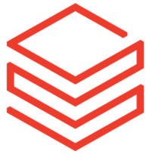

Unity Catalog Unlocks Full Potential of your Lakehouse | w/ UC | w/ Hive Metastore
Governance across workspaces (Access controls, metastore, Identity management) | ✅ | ❌ (Governance at workspace level)
Automated table and column level lineage in real-time | ✅ | ❌
Row Filters and Column Masking (use standard SQL functions for fine-grained access controls) | ✅ | ❌
Volumes (Govern non tabular data/arbitrary files - image, video, PDF etc.) | ✅ | ❌
Lakehouse Federation (Discover, govern and query external databases, data warehouses, Hive Metastore, AWS Glue) | ✅ | ❌
Lakehouse Monitoring (Monitor quality of data and ML models with auto generated alerts and dashboards) | ✅ | ❌
Delta Sharing (Share files, tables, ML models, notebooks across clouds, regions and data platforms) | ✅ | ❌
Databricks Marketplace | ✅ | ❌
Databricks Cleanroom (Collaboration on data in a privacy-preserving manner) | ✅ | ❌
AI/BI Genie | ✅ | ❌
Databricks Assistant | ✅ | ❌ (Degraded experience)
Governance for AI (manage and govern ML Models, Feature store) | ✅ | ❌
System Tables (end to end observability for Billing, Auditing, Lineage, Marketplace analytics) | ✅ | ❌
Databricks Apps | ✅ | ❌
Databricks Connect V2 | ✅ | ❌
Materialized Views | ✅ | ❌
AI Powered Predictive optimization (optimizes your query plans and data layout for peak performance, intelligently balancing read vs. write performance) | ✅ | ❌
Streaming Tables | ✅ | ❌
Vector Search for indexing | ✅ | ❌
Serverless workflows | ✅ | ❌
Notes:
A lot of new capabilities need Unity where it’s just not possible on HMS. HMS has no place for storing all of the extra metadata, system tables, lineage,...

Slide 9

All your metadata, in one place
One metadata layer across file and database sources superpowers governance
Without Unity Catalog
With Unity Catalog
Databricks Workspace 1
Databricks Workspace 2
Unity Catalog
User Management
Metastore
Foreign Databases
Access Controls
User Management
User Management
Metastore
Metastore
Databricks Workspace
Databricks Workspace
Access Controls
Access Controls
Clusters SQL Warehouses
Clusters SQL Warehouses
Clusters SQL Warehouses
Clusters SQL Warehouses
Notes:
So prior to Unity Catalog, the concept of a workspace was somewhat monolithic. This was for 3 principal reasons
You had to define users and groups at each workspace, either manually or through some SCIM Synchronization with your Federated Identity Platform.
You also by default had a metastore that could only be used with one workspace.
In addition to that, all access controls existed only in the workspace scope and couldn’t be used outside of that workspace without duplication.
At the end of the day, this results in a higher operational overhead and a lack of efficiency, as well as an inconsistent and non centralized view of your data estate and potentially inconsistent controls on your data
With Unity Catalog, we move these 3 concepts out of workspaces, and into a new object that works orthogonally across all workspaces. This object is called an Account. The Account, including the Account Console, which is a user interface to control the Account, lives purely in the control plane, and as such there is NO customer compute associated with these objects and services.
You will typically have one Account per organization (i.e. your entire company) per cloud provider. Now you can setup data, controls, and user management in one place, and use them across multiple workspaces.

Slide 10
Fundamental Concepts
Working with file based data sources
Working with databases
Credentials
Storage Credential to connect to storage
Cloud Service Credential to connect native services
External Locations
Storage location used for tables, files or volumes
Tables
For managing tabular data
Volumes
File container to govern a folder on cloud storage
Connections
Credential and connection information to connect to an external database
Foreign Catalogs
A catalog that represents an external database in UC and can be queried alongside managed data sources and file sources
Notes:
Tables and Volumes along with Schemas and Catalogs are mapped to a storage location. A Storage Location connects to a Cloud Storage account or Bucket. The Cloud Storage Connector connects to the underlying cloud storage service.l

Slide 11
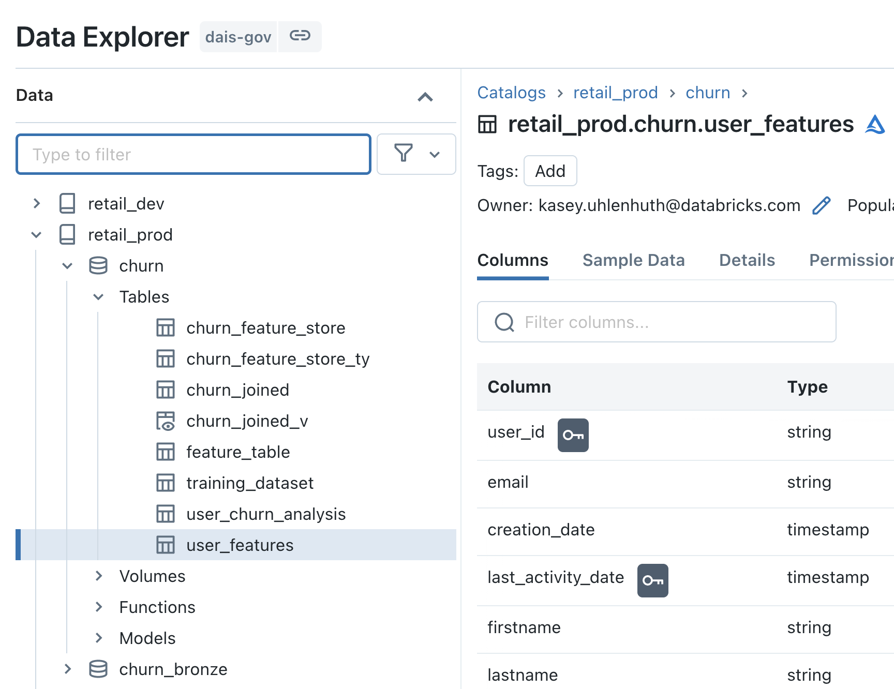
Governed namespace across file and database sources
Access legacy metastore and foreign databases powered by Lakehouse Federation
Unity Catalog
hive_metastore
(legacy)
Foreign Catalog
Catalog 1
default (database)
Foreign Schema
Schema 1
customers
(table)
Foreign Table
External Table
Models/ Functions
Views
Managed / Ext Tables
Volumes
SELECT * FROM main.paul.red_wine; -- <catalog>.<database>.<table>
SELECT * FROM hive_metastore.default.customers;
SELECT * FROM snowflake_warehouse.some_schema.some_table;
Notes:
Prior to Unity Catalog, a workspace was effectively a logical point of data segregation.
With Unity Catalog, we needed to add an additional layer of data segregation, so we added a 3rd level of namespacing called a catalog.
A catalog is an object that contains databases, databases like you’re familiar with from Hive and traditional RDBMS’ contain views, and tables.
We also provide the legacy hive metastore in each workspace as a catalog object called “hive_metastore” in Unity Catalog. While this is not strictly part of the catalog, and you cannot write ACLs on this hive metastore that live in Unity Catalog, it allows for you to seamlessly access your old tables, ensuring that as part of your upgrade, your jobs, dashboards, and other query experiences are not impacted. Note, legacy TACLs will still work on the legacy hive metastore on TACL enabled clusters and DBSQL.

Slide 12
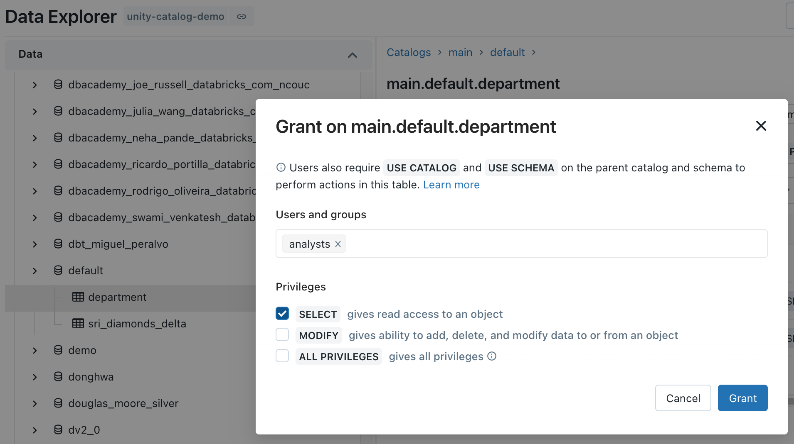
Centralized Access Controls
Centrally grant and manage access permissions across workloads
Using ANSI SQL DCL
Using UI
GRANT <privilege> ON <securable_type> <securable_name> TO `<principal>`
GRANT SELECT ON iot.events TO engineers
Choose permission level
‘Table’= collection of files in S3/ADLS
Sync groups from your identity provider
Notes:
One of the tenants that we embrace as a company, is to make things simple. ANSI SQL DCL, the data control language specification part of ANSI SQL, is a familiar interface for RDBMS users and admins alike. This allows you to grant permission scopes on securable objects like tables or locations to principals like groups, users, or service principals.
The same level of functionality is available via our UI in an easy to use point and click manner, which helps for easy access auditing on the spot.
In addition to that, we offer the ability to set these ACLs on objects via our RESTful APIs, which means that anything, from legacy entitlement request processes to modern dev/sec/ops initiatives can be supported and powered by Unity Catalog.
The interesting thing to note with API and UI based ACL grants, is that they are done outside the context of compute, purely through our control plane APIs.

Slide 13
Row Level Security and Column Level Masking
Provide differential fine grained access to datasets
Only show specific rows
Mask or redact sensitive columns
CREATE FUNCTION <name> ( <parameter_name > <parameter_type> .. )
RETURN {filter clause whose output must be a boolean}
CREATE FUNCTION <name> (<parameter_name>, <parameter_type>, [, <column>...])
RETURN {expression with the same type as the first parameter}
CREATE FUNCTION us_filter(region STRING)
RETURN IF(IS_MEMBER(‘admin’), true, region=“US”);
ALTER TABLE sales SET ROW FILTER us_filter ON region;
CREATE FUNCTION ssn_mask(ssn STRING)
RETURN IF(IS_MEMBER(‘admin’), ssn, “****”);
ALTER TABLE users ALTER COLUMN table_ssn SET MASK ssn_mask;
Test for group membership
Assign reusable filter to table
Test for group membership
Assign reusable mask to column
Specify filter predicates
Specify mask or function to mask

Slide 14
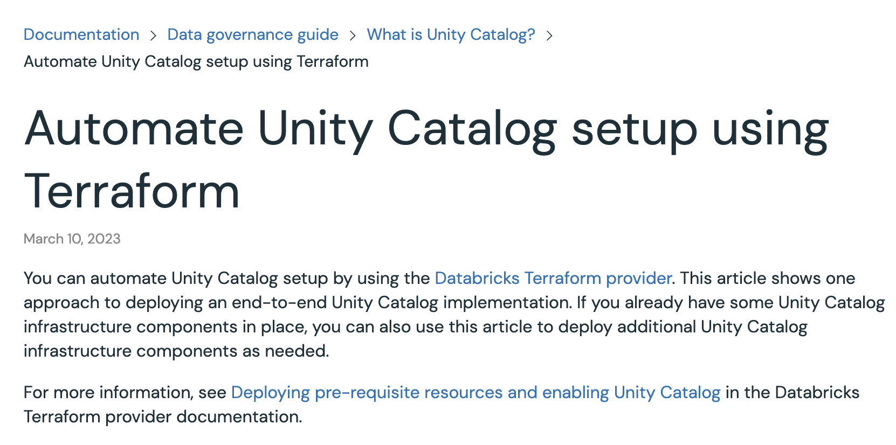
Working with Terraform & APIs
Use data-sec-ops, policies as code patterns to scale your efforts
Privileges for UC objects can be managed programmatically using our Terraform provider, especially for teams already using Terraform
This will pair naturally with the management of the UC objects (Metastore, Catalog, Assignments etc.) themselves.
(If not already using Terraform, maybe now is a good time!)
resource "databricks_grants" "sandbox" {
provider = databricks.workspace
catalog = databricks_catalog.sandbox.name
grant {
principal = "Data Scientists"
privileges = ["USAGE", "CREATE"]
}
grant {
principal = "Data Engineers"
privileges = ["USAGE"]
}
}

Slide 15





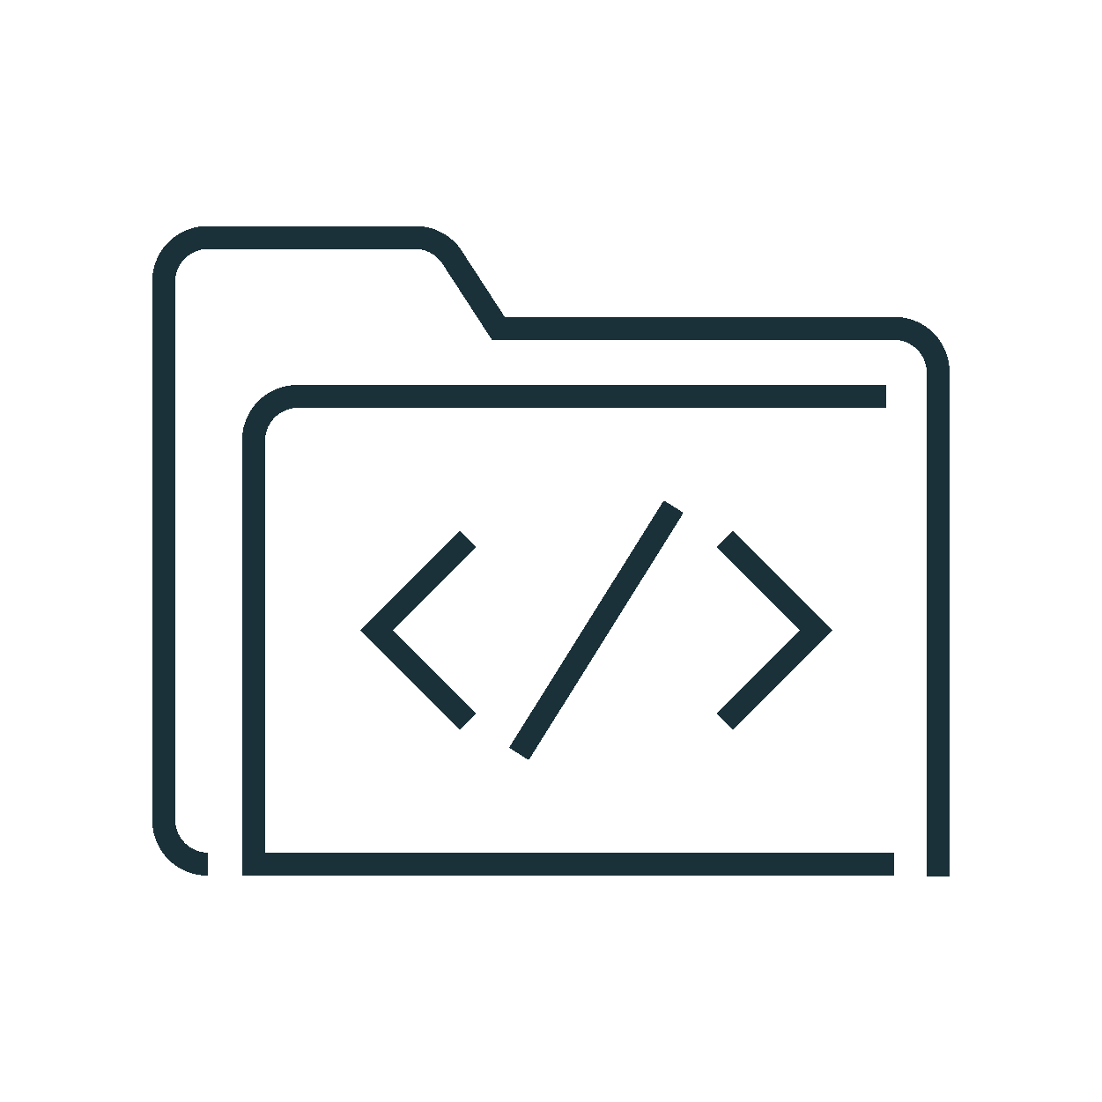
Managed Data Sources & External Locations
Simplify data access management across clouds
Audit log
Unity Catalog
External Locations & Credentials
Access Control
Cloud Storage (S3, ADLS, GCS)
Managed tables
Managed Data Sources
Managed container / bucket
Cluster or SQL warehouse
User
External tables
External container / bucket
…
External Locations
Files in Cloud Strg
External container / bucket
Notes:
Prior to Unity Catalog Credentials to access cloud storage like S3 or ADLS were defined at the cluster or warehouse or in a passthrough mechanism based on the user’s cloud identity.
With Unity Catalog, those Credentials live as first class primitive objects in your Unity metastore. They have ACLs on them like any other object, but they are typically not used by users directly.
When you set up a Unity Catalog Metastore for the first time, you will associate a managed data source with that metastore. This managed data source is a container or bucket that will only be read from and written to via Databricks, through Unity Catalog. Along with this managed datasource is a default credential object that will be used for Unity to broker access to this data. I will explain the request path of how Unity Catalog does this in the next slide.
But to flesh out these concepts, if you create a table in legacy HMS, and you don’t specify a location for that table, it by default will be stored in DBFS. This is known as a managed table in Hive and the default location in Databricks is DBFS.
In Unity, this is very similar, we have a concept of a managed table. that when you create a table without a specified location, it will use the managed data source associated with your metastore to store the table. Managed tables have to be Delta Tables.
There is another first class primitive object within Unity called an External Location. An External Location is a combination of two things, a cloud URL and a Credential. It is an object that can have it’s own ACLs on it and allows users to READ/WRITE or CREATE TABLEs inside it. This is how users can get access to arbitrary files in cloud storage.
If you create a table using a location that belongs to an external location that you have the CREATE TABLE right on, you can now federate this externally defined table to anywhere in your metastore hierarchy. External tables can be delta, parquet, avro, orc, or a number of other supported formats.

Slide 16
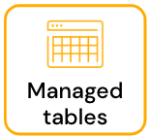
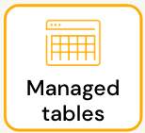
Default access to storage by catalog or schema
Use managed data sources for data isolation or cost allocation
Unity Catalog
Cloud Storage (S3, ADLS, GCS)
strong recommendation: do not store catalogs/schemas in the metastore-level default location
.
.
.
rather, specify
a separate managed storage location for each catalog
(which becomes the default location for schemas/tables w/in that catalog)
1) default storage associated with the metastore
Metastore
optional
default Managed container / bucket
Catalog1
Schema1
2) define at the catalog
Catalog2
Managed container / bucket
Schema2
3) define at the schema
Schema3
Managed container / bucket
Notes:
Best practice these days for large organizations is to not have default storage for the metastore.

Slide 17
Govern filesystems and objects distinctly
Govern external tables and filesystem access separately
Cloud Storage (S3, ADLS, GCS)
Unity Catalog
READ/WRITE
External Location
Access Control
Volume
Volume
User
WRITE OPERATION
Table
Data
SELECT ONLY
Writes to the table or table data via a path does not use the WRITE permission from the External Location

Slide 18
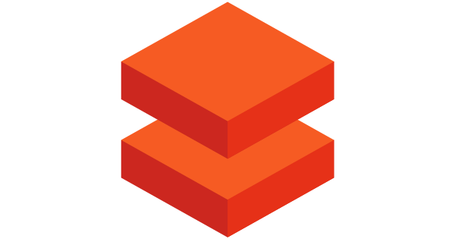
Access data from specified environments only
Restrict data access by environment or purpose
Catalogs
Workspaces
Groups
dev
dev_ws
Developers
staging
staging_ws
Testers
Metastore
Access to data and availability of data can be isolated across workspaces and groups
prod
prod_ws
Analysts
bu_1_dev
bu_dev_stg_ws
BU Developers
bu_1_staging
BU Testers
bu_1_prod
bu_prod_ws
BU Users

Slide 19



Querying file based data sources with Unity
Creates an IAM role (AWS)/ Managed Identity (Azure) / Service Account (GCP)
Creates storage credentials/ external locations in Unity Catalog
Defines access policies in Unity Catalog
Admin
Check namespace , metadata and grants
2
Write
audit log
Cluster or SQL warehouse
Unity Catalog
Audit log
Send query (SQL
Python, R, Scala,)
Return list of paths/data files and scoped down temporary tokens
User
1
4
Assume IAM Role /
Managed Identity / Service Account
3
8
Send result
Request/ingest data from paths/data files with temporary tokens
5
Cloud Storage
Enforce policies
7
Return data
(S3, ADLS, GCS)
6
Notes:
Let me run you through the life of a query with Unity Catalog
A user submits a query or action, this can be any query/action on any language, Python, R, Scala, SQL. Unity Catalog works across all languages.
This query hits an warehouse or cluster, this can be a standard, user isolation or multi user cluster, a DBSQL Warehouse or a Serverless DBSQL Warehouse, Unity Catalog works across all compute.
The first thing that warehouse or cluster does is hit Unity’s control plane services, to check the namespace, metadata and evaluate the grants for that user.
UC will evaluate whether or not that user has access to read the objects specified in the query or action, a pass or a fail
Depending on that, an appropriate audit log record will be written out.
In the event the user has access, UC will, for each object in the query or action, assume the underlying Credential that controls the external location or managed datasource where that object resides
This could be a Service Principal or an IAM Role
UC will return short lived tokens, roles, or signed URLs to the cluster/warehouse
Short lived is 1 hour
These are presigned urls or downscoped roles in S3 or SAS URLs in ADLS
Keep in mind steps 2,3,4 are control plane activity, so this operation happens in milliseconds
Once the cluster or warehouse has these tokens or presigned urls it will go grab the data files directly from Cloud storage.
UC is not in the path of data.
–
Because UC will grant access to data at the partition level, the last mile of filtering for row level filtering or column level filtering will happen on the cluster or warehouse
Before the information is finally sent back to the user or requestor.

Slide 20
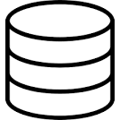
Querying database sources with Unity
Defines Connection object with JDBC connection information to database.
Registers foreign catalog
Defines access policies in Unity Catalog
Admin
Check namespace , metadata and grants, enforce policies
2
Write
audit log
Cluster or SQL warehouse
Unity Catalog
Audit log
Send query (SQL
Python, R, Scala,)
Returns encrypted credential information to the cluster or warehouse
User
1
3
Metadata changes in the data are pushed to UC Control Plane
Send result
Request / ingest data with predicate pushdown by directly connecting to database
5
7
4
(Snowflake, SQL Server, Postgres, Mysql, etc)
JDBC Database
6
Return data
Notes:
Let me run you through the life of a query with Unity Catalog
A user submits a query or action, this can be any query/action on any language, Python, R, Scala, SQL. Unity Catalog works across all languages.
This query hits an warehouse or cluster, this can be a standard, user isolation or multi user cluster, a DBSQL Warehouse or a Serverless DBSQL Warehouse, Unity Catalog works across all compute.
The first thing that warehouse or cluster does is hit Unity’s control plane services, to check the namespace, metadata and evaluate the grants for that user.
UC will evaluate whether or not that user has access to read the objects specified in the query or action, a pass or a fail
Depending on that, an appropriate audit log record will be written out.
In the event the user has access, UC will, for each object in the query or action, assume the underlying Credential that controls the external location or managed datasource where that object resides
This could be a Service Principal or an IAM Role
UC will return short lived tokens, roles, or signed URLs to the cluster/warehouse
Short lived is 1 hour
These are presigned urls or downscoped roles in S3 or SAS URLs in ADLS
Keep in mind steps 2,3,4 are control plane activity, so this operation happens in milliseconds
Once the cluster or warehouse has these tokens or presigned urls it will go grab the data files directly from Cloud storage.
UC is not in the path of data.
–
Because UC will grant access to data at the partition level, the last mile of filtering for row level filtering or column level filtering will happen on the cluster or warehouse
Before the information is finally sent back to the user or requestor.

Slide 21
Volumes in Unity Catalog
Access, store, organize and process files with Unity Catalog governance
Volumes can be accessed by POSIX commands
Volumes are created under Managed or External Locations and show up in UC Lineage
Volumes add governance over non-tabular data sets
Unstructured data, e.g., image, audio, video, or PDF files, used for ML
Semi-structured training, validation, test data sets, used in ML model training
Raw data files used for ad-hoc or early stage data exploration, or saved outputs
Library or config files used across workspaces
Operational data, e.g., logging or checkpointing output files
Tables are registered in Managed / External Locations, not in Volumes
Cloud Storage (S3, ADLS, GCS)
dbutils.fs.ls(“s3://my_external_location/Volumes/volume123”)
Managed / External Location
ls /Volumes/volume123
Volume
Volume
Data
Data
Table

Slide 22
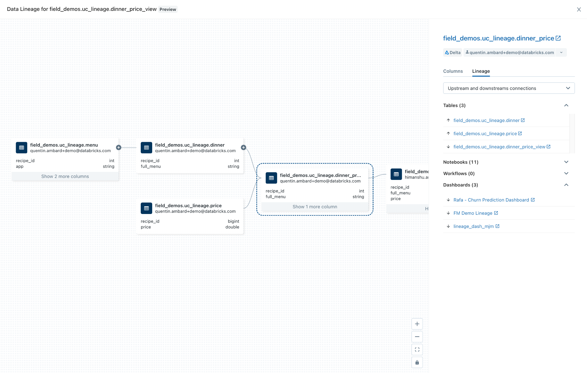
Automated lineage for all workloads
End-to-end visibility into how data flows and consumed in your organization
Auto-capture runtime data lineage on a Databricks cluster or SQL warehouse
Track lineage down to the table and column level
Leverage common permission model from Unity Catalog
Lineage across tables, dashboards, workflows, notebooks, feature tables, files, and DLT
Notes:
So lineage is pretty exciting! We now have the ability to automatically capture runtime lineage on clusters and sql warehouses down to the column level. So that means if you create a derivative data set based on another dataset through the Spark APIs, you will be to see that relationship in an immutable form through our UI and APIs.

Slide 23





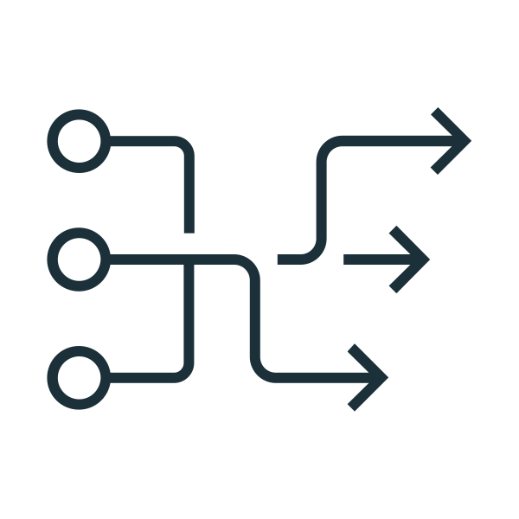

Lineage flow - How it works
ETL / Job
Explore lineage in UI
Workspace cluster / SQL Warehouse
Lineage service
Table and column lineage
Ad-hoc
Alation
Microsoft Purview
Collibra
DLT
External Catalogs
Code (any language) is submitted to a cluster or SQL warehouse or DLT* executes data flow
Lineage service analyzes logs emitted from the cluster, and pulls metadata from DLT
Assembles column and table level lineage
Presented to the end user graphically in Databricks
Lineage can be exported via API and imported into other tool
Notes:
So let’s talk a bit about how Lineage actually works.
So a user submits a job or code, to a cluster or warehouse, every sql select or spark operation eventually results in sequences of Transformations or Actions, like map or read etc.
Before spark goes off and parallelizes these operations to its worker nodes, it creates something called a LogicalPlan. This is an abstraction of all transformations, in a linked graph form. The metadata of this object get submitted to a lineage service, this runs in the control plane. This service assembles all of these logical plans for all commands together to create lineage graphs that then get boiled down into tabular information about what tables fed into other tables and what columns fed into other columns. This allows you to see things like upstream and downstream consumers of any particular table or column.
This is then exposed to our UI to see that pretty graph you saw on the previous screen and also exposed through our REST APIs to support integrations with Catalog products like Alation, Collibra, and Microsoft Purview.

Slide 24
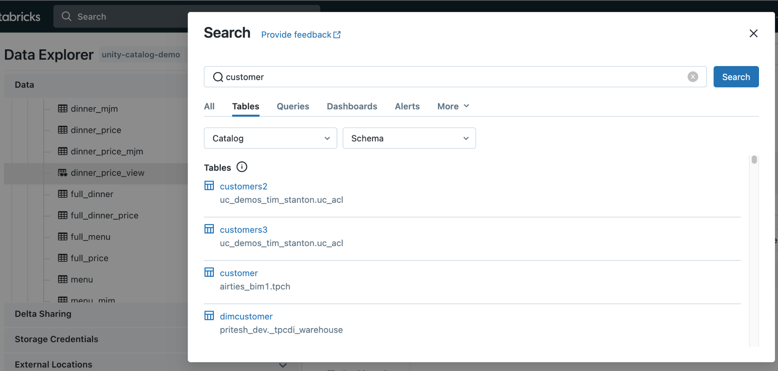
Built-in search and discovery
Accelerate time to value with low latency data discovery
UI to search for data assets stored in Unity Catalog
Unified UI across DSML + DBSQL
Leverage common permission model from Unity Catalog
Apply semantic tags to data and search across tags
Notes:
We’ve also introduced Data Discovery, which is an integrated User Interface to discover assets in Unity Catalog. This is a unified UI across personas and it leverages the common permission model from UC, so if you don’t have access to see or read a table, it will not show up in your search results.

Slide 25
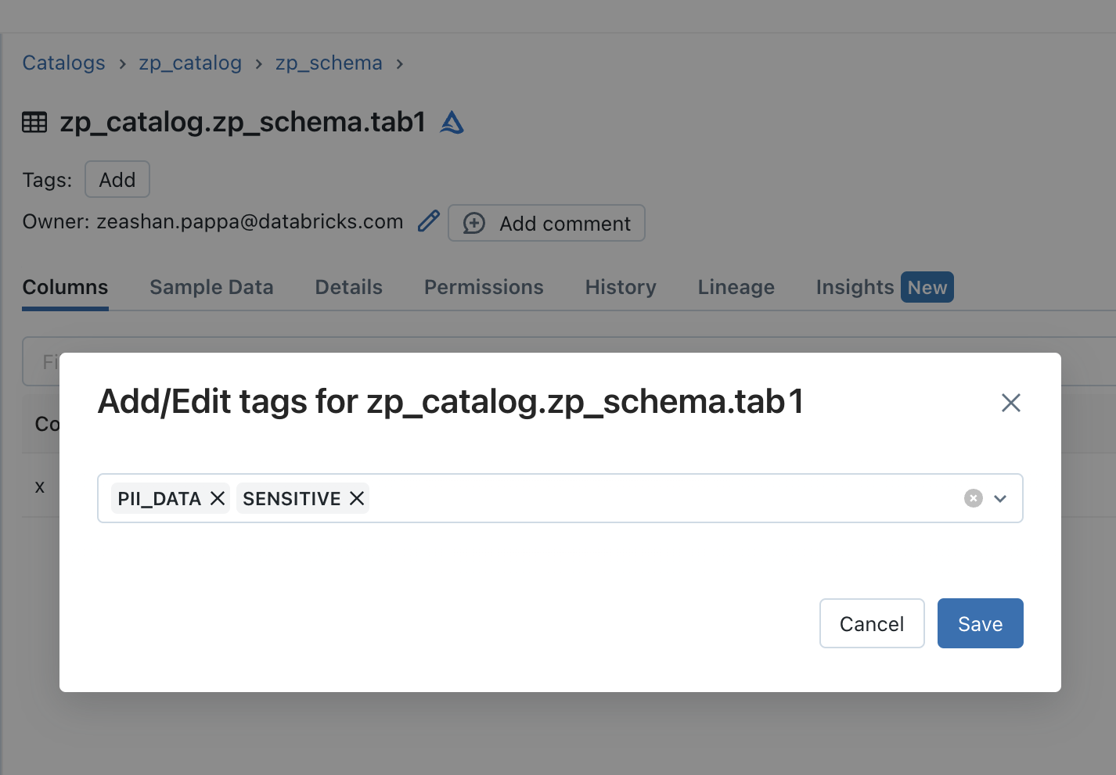
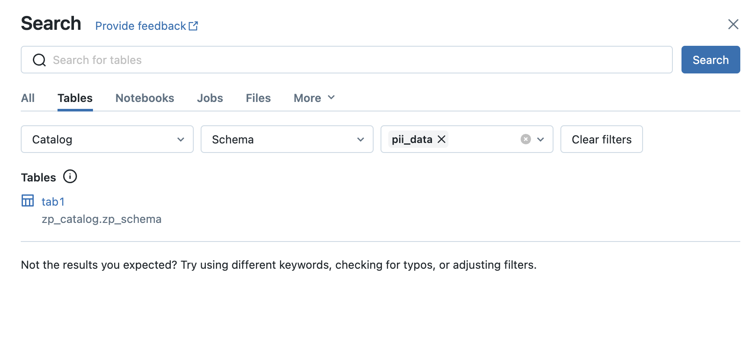
Discovery Tags
Semantic layer for your lakehouse
Problem
Searching for data assets in business terms or generally agreed upon taxonomies usually requires additional catalog tools.
Solution
Discovery Tags allow you to tag Column, Table, Schema, Catalog objects in UC
Integrated search mechanism in UC allows you to search for objects by tag.
Tag your data
Search based on tags

Slide 26
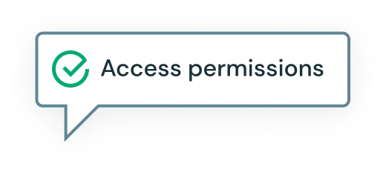
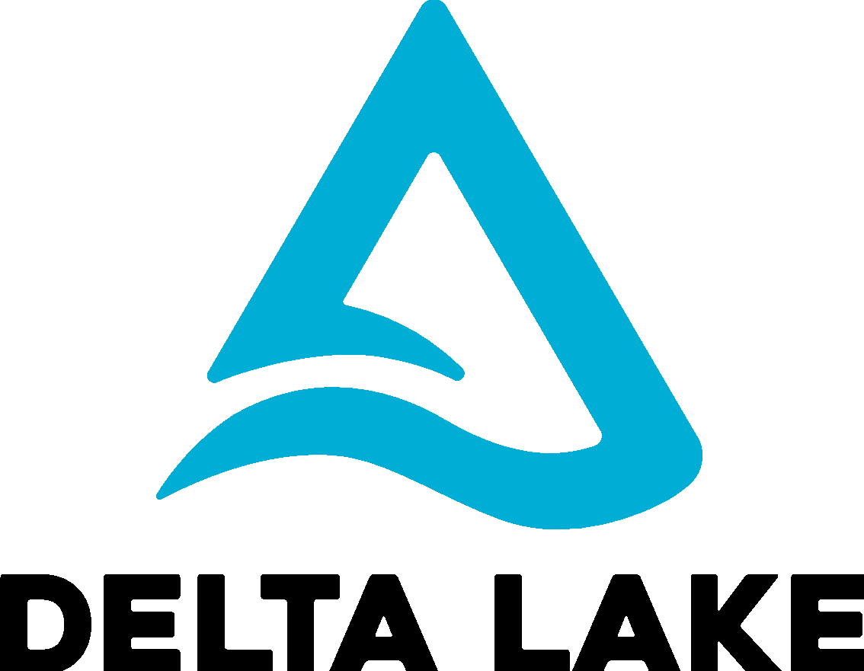
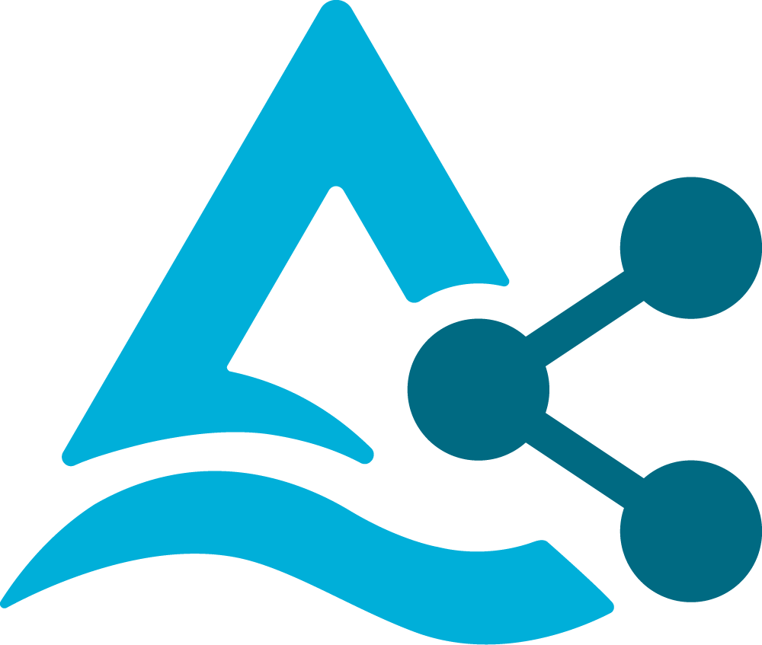

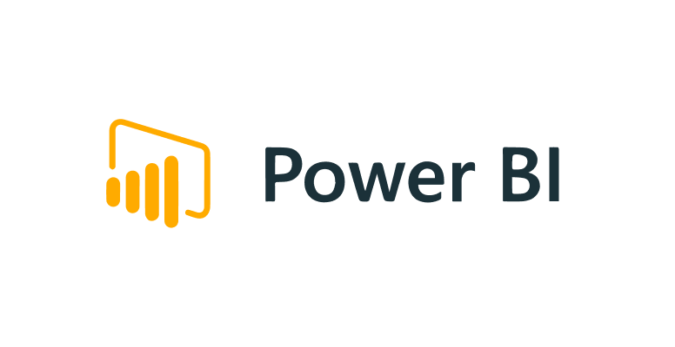
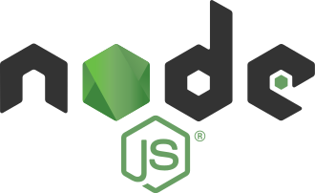
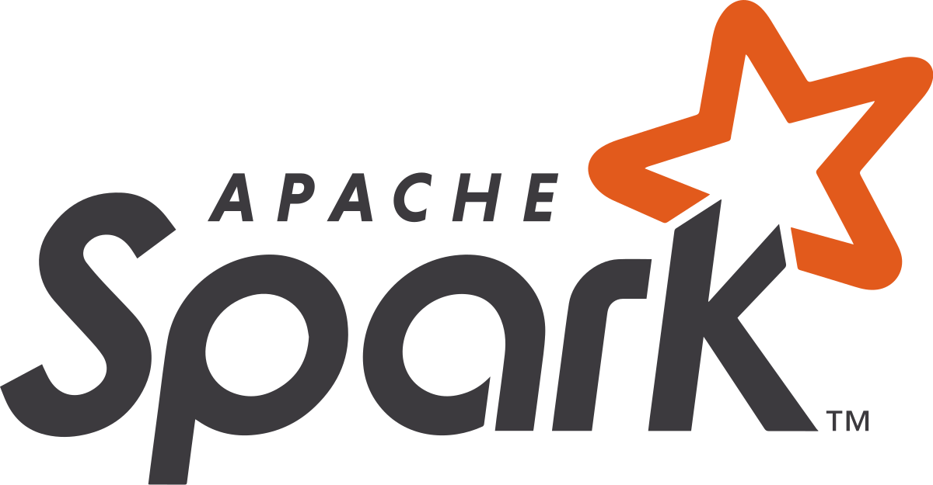
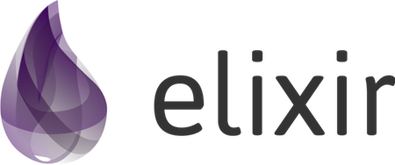
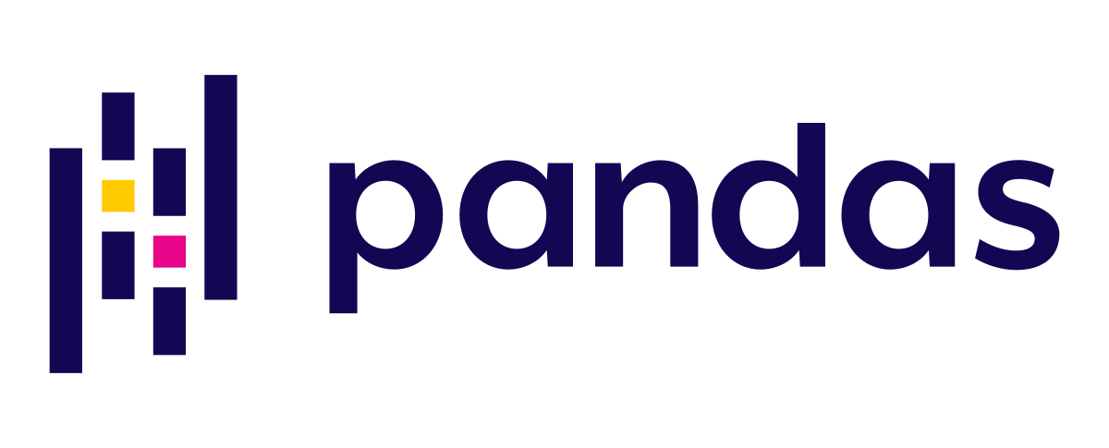
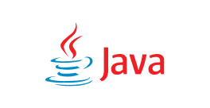

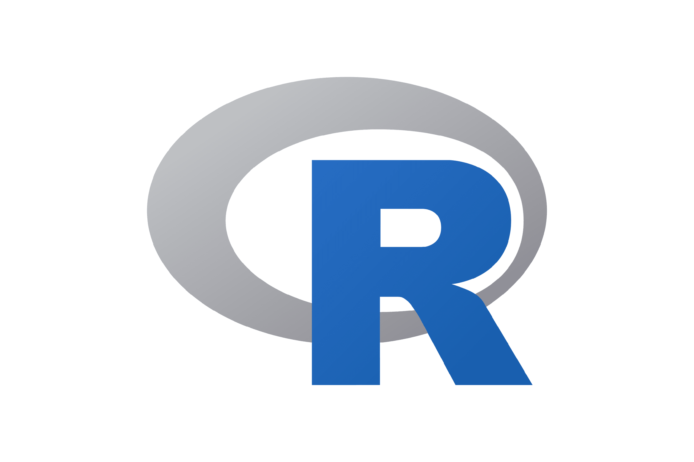
Delta Sharing
DATA PROVIDER
DATA CONSUMER
Activation link
Request table
Pre-signed short-lived URLs
Delta Lake
Delta Sharing Server
Delta Sharing Connectors
Temporary direct access to files (Delta format) in the object store - AWS S3, GCP, ADLS
Delta files
in cloud storage
…
Notes:
But how does it work?
There are 2 parties involved, the data Provider and the data Consumer.
The Provider can set up a Delta Sharing server for their existing data lake, which can be on AWS, Azure, or Google Cloud.
They can set up sharing rules, or access permissions, on the sharing server which specify which Consumer has access to what dataset.
For each Consumer, the sharing server generates an activation link which the Provider sends to the Consumer, and the Consumer downloads a token file containing their credentials.
The Consumer then uses these credentials to configure any of the Delta Sharing clients like Pandas, Spark, PowerBI to consume the data from their computing platform of choice.
When the sharing server receives a request to read shared data, it checks the access permissions on the credentials and then generates and returns pre-signed short-lived URLs to the client, which can fetch the data directly from the S3 or ADLS cloud storage.
Currently Delta Sharing supports Parquet, which is an open data format, so any client that reads Parquet can support Delta Shares. This makes it easy for Consumers to read shared data from their compute of choice, and Providers don’t need to transfer any data. It’s secure, audited, and governed.
THIS PAGE HAS ANIMATIONS
Under the hood, when the sharing server receives a request from a client to read shared data, it checks the access permissions on the credentials. If the check succeeds, the server generates and returns pre-signed short-lived URLs to the client, which can fetch the data directly from the S3 or ADLS cloud storage.
Currently Delta Sharing supports Parquet, which is an open data format, so any client that reads Parquet can support Delta Shares. This makes it easy for Consumers to read shared data from their compute of choice, and Providers don’t need to transfer any data. It’s secure, audited, and governed.
—-----
Old notes
Provider is on databricks and the recipient can use any compute platform of choice
based on open standards, there's Parquet underneath, and then there's this technology called Delta Lake on top, which adds governance and database-like characteristics on top of your data lake.
You mount the delta sharing server to your data lake (within Databricks this is a managed service), and then you can dictate who can access it, but from any system.
Consumers can pull it from another cloud, or another data engine
Let's just say you happen to be on Amazon, it's the same for Azure or Google, and all of your data's in S3.
When you have your data in S3 and you want to share it with someone, you indicate through your Delta Sharing server, that they have access to that table or that view, and then when they request that table, you mint a pre-signed short-lived URL.
It's a signed URL, this is technology that's in S3. they can use this pre-signed URL to fetch it from the infrastructure where you already have it managed.
They can easily read Delta-Shared data, from their compute of choice but you don't have to move it, and it's secure, audited, and governed.
Delta sharing makes its easy manage all access controls, you have auditability, and full governance on this through the delta sharing server
It's leveraging this, and you see how in this way it can work across clouds and across different data stacks.

Slide 27



Delta Sharing - Under the hood
Data Provider
Data Recipient
Delta Sharing Protocol:
Client authenticates to Sharing Server
Client requests a table (including filters)
Server checks access permissions
Server generates and returns pre-signed short-lived URLs
Client uses URLs to directly read files from object storage
Access Permissions
Delta Sharing Protocol
request table
pre-signed short-lived URLs
Delta Table
Delta Sharing Server
Delta Sharing Client
Notes:
Sharing happens on Delta part files, supporting full tables, partitions, delta versions, …
Client is system independent, just needs to be able to read parquet files
In Databricks Sharing Server and ACL checks are integrated with Unity Catalog
Power BI
direct access to files (parquet format) in the object store
Parquet files
…
Notes:
But how does it work?
There are 2 parties involved, the data Provider and the data Consumer.
The Provider can set up a Delta Sharing server for their existing data lake, which can be on AWS, Azure, or Google Cloud.
They can set up sharing rules, or access permissions, on the sharing server which specify which Consumer has access to what dataset.
For each Consumer, the sharing server generates an activation link which the Provider sends to the Consumer, and the Consumer downloads a token file containing their credentials.
The Consumer then uses these credentials to configure any of the Delta Sharing clients like Pandas, Spark, PowerBI to consume the data from their computing platform of choice.
When the sharing server receives a request to read shared data, it checks the access permissions on the credentials and then generates and returns pre-signed short-lived URLs to the client, which can fetch the data directly from the S3 or ADLS cloud storage.
Currently Delta Sharing supports Parquet, which is an open data format, so any client that reads Parquet can support Delta Shares. This makes it easy for Consumers to read shared data from their compute of choice, and Providers don’t need to transfer any data. It’s secure, audited, and governed.
THIS PAGE HAS ANIMATIONS
Under the hood, when the sharing server receives a request from a client to read shared data, it checks the access permissions on the credentials. If the check succeeds, the server generates and returns pre-signed short-lived URLs to the client, which can fetch the data directly from the S3 or ADLS cloud storage.
Currently Delta Sharing supports Parquet, which is an open data format, so any client that reads Parquet can support Delta Shares. This makes it easy for Consumers to read shared data from their compute of choice, and Providers don’t need to transfer any data. It’s secure, audited, and governed.
—-----
Old notes
Provider is on databricks and the recipient can use any compute platform of choice
based on open standards, there's Parquet underneath, and then there's this technology called Delta Lake on top, which adds governance and database-like characteristics on top of your data lake.
You mount the delta sharing server to your data lake (within Databricks this is a managed service), and then you can dictate who can access it, but from any system.
Consumers can pull it from another cloud, or another data engine
Let's just say you happen to be on Amazon, it's the same for Azure or Google, and all of your data's in S3.
When you have your data in S3 and you want to share it with someone, you indicate through your Delta Sharing server, that they have access to that table or that view, and then when they request that table, you mint a pre-signed short-lived URL.
It's a signed URL, this is technology that's in S3. they can use this pre-signed URL to fetch it from the infrastructure where you already have it managed.
They can easily read Delta-Shared data, from their compute of choice but you don't have to move it, and it's secure, audited, and governed.
Delta sharing makes its easy manage all access controls, you have auditability, and full governance on this through the delta sharing server
It's leveraging this, and you see how in this way it can work across clouds and across different data stacks.

Slide 28
Thank you

Slide 29
Appendix

Slide 30

Unity Catalog and Catalog Partners Better together
Catalog of catalogs (e.g. Collibra, Alation, Purview …)
ETL Tool
Cloud DWH
Domains
Catalog X
Unity Catalog
Catalog Y
E2E Pipeline
Orchestrator (e.g. Airflow)
Lineage information flow:
Pipeline step sending lineage to domain’s catalog (e.g. UC)
Domain’s catalog to global catalog of catalogs

Slide 31


Unity Catalog and Governance Partners Better together
Greatly improves the experience in Immuta and Privacera:
No longer limits the languages that these products can work in
No longer limits the APIs that your users can use
Improves performance and robustness
Adds a common enforcement layer
Policy Specification
Policy Enforcement
Cluster or SQL warehouse
Unity Catalog

Slide 32
Databricks Unity Catalog
Centralized Governance
Audit Log
Identity Provider
Metastore
Account Level User Mgmt
Unity Catalog
Lineage Explorer
Storage Credentials
Data Explorer
ACL Store
Access Control
Cloud Storage (S3, ADLS, GCS)
user
Databricks Workspace
user
✔
Container / bucket
✔
X
user
Databricks Workspace
X
Container / bucket
user
✔
Container / bucket
✔
user
Delta Sharing Client
user
Delta Sharing Server
✔
Short-lived token
X
Access denied

Slide 33
Object relations with Unity Catalog (UC)
Databricks Account Console
Databricks Account
Account Level
User Management
sync users and groups
Identity Provider
has
has
has
has
uses
Databricks Workspace
(Control Plane)
assigned to
(Unity) Metastore
links to and manages
Default Cloud Storage
has
has
has
has
Cluster / SQL Warehouse
External Cloud Storages
has
Recipients
Credential Storage
Catalog Storage
External Locations
links to
Delta
Sharing
read / write
can access
has
Shares
has
catalog.db.table
Hive Metastore
has
Notes:
Using Unity Catalog is optional. Workspaces can still use a Hive Metastore only
There can be more than one Unity Metastore (UC) per Databricks Account (e.g. for regional isolation or for isolation of lines of business)
Every workspace can only attach to one UC Metastore, however one Unity Metastore can be assigned to several Workspaces
‹#›

